Slide 1
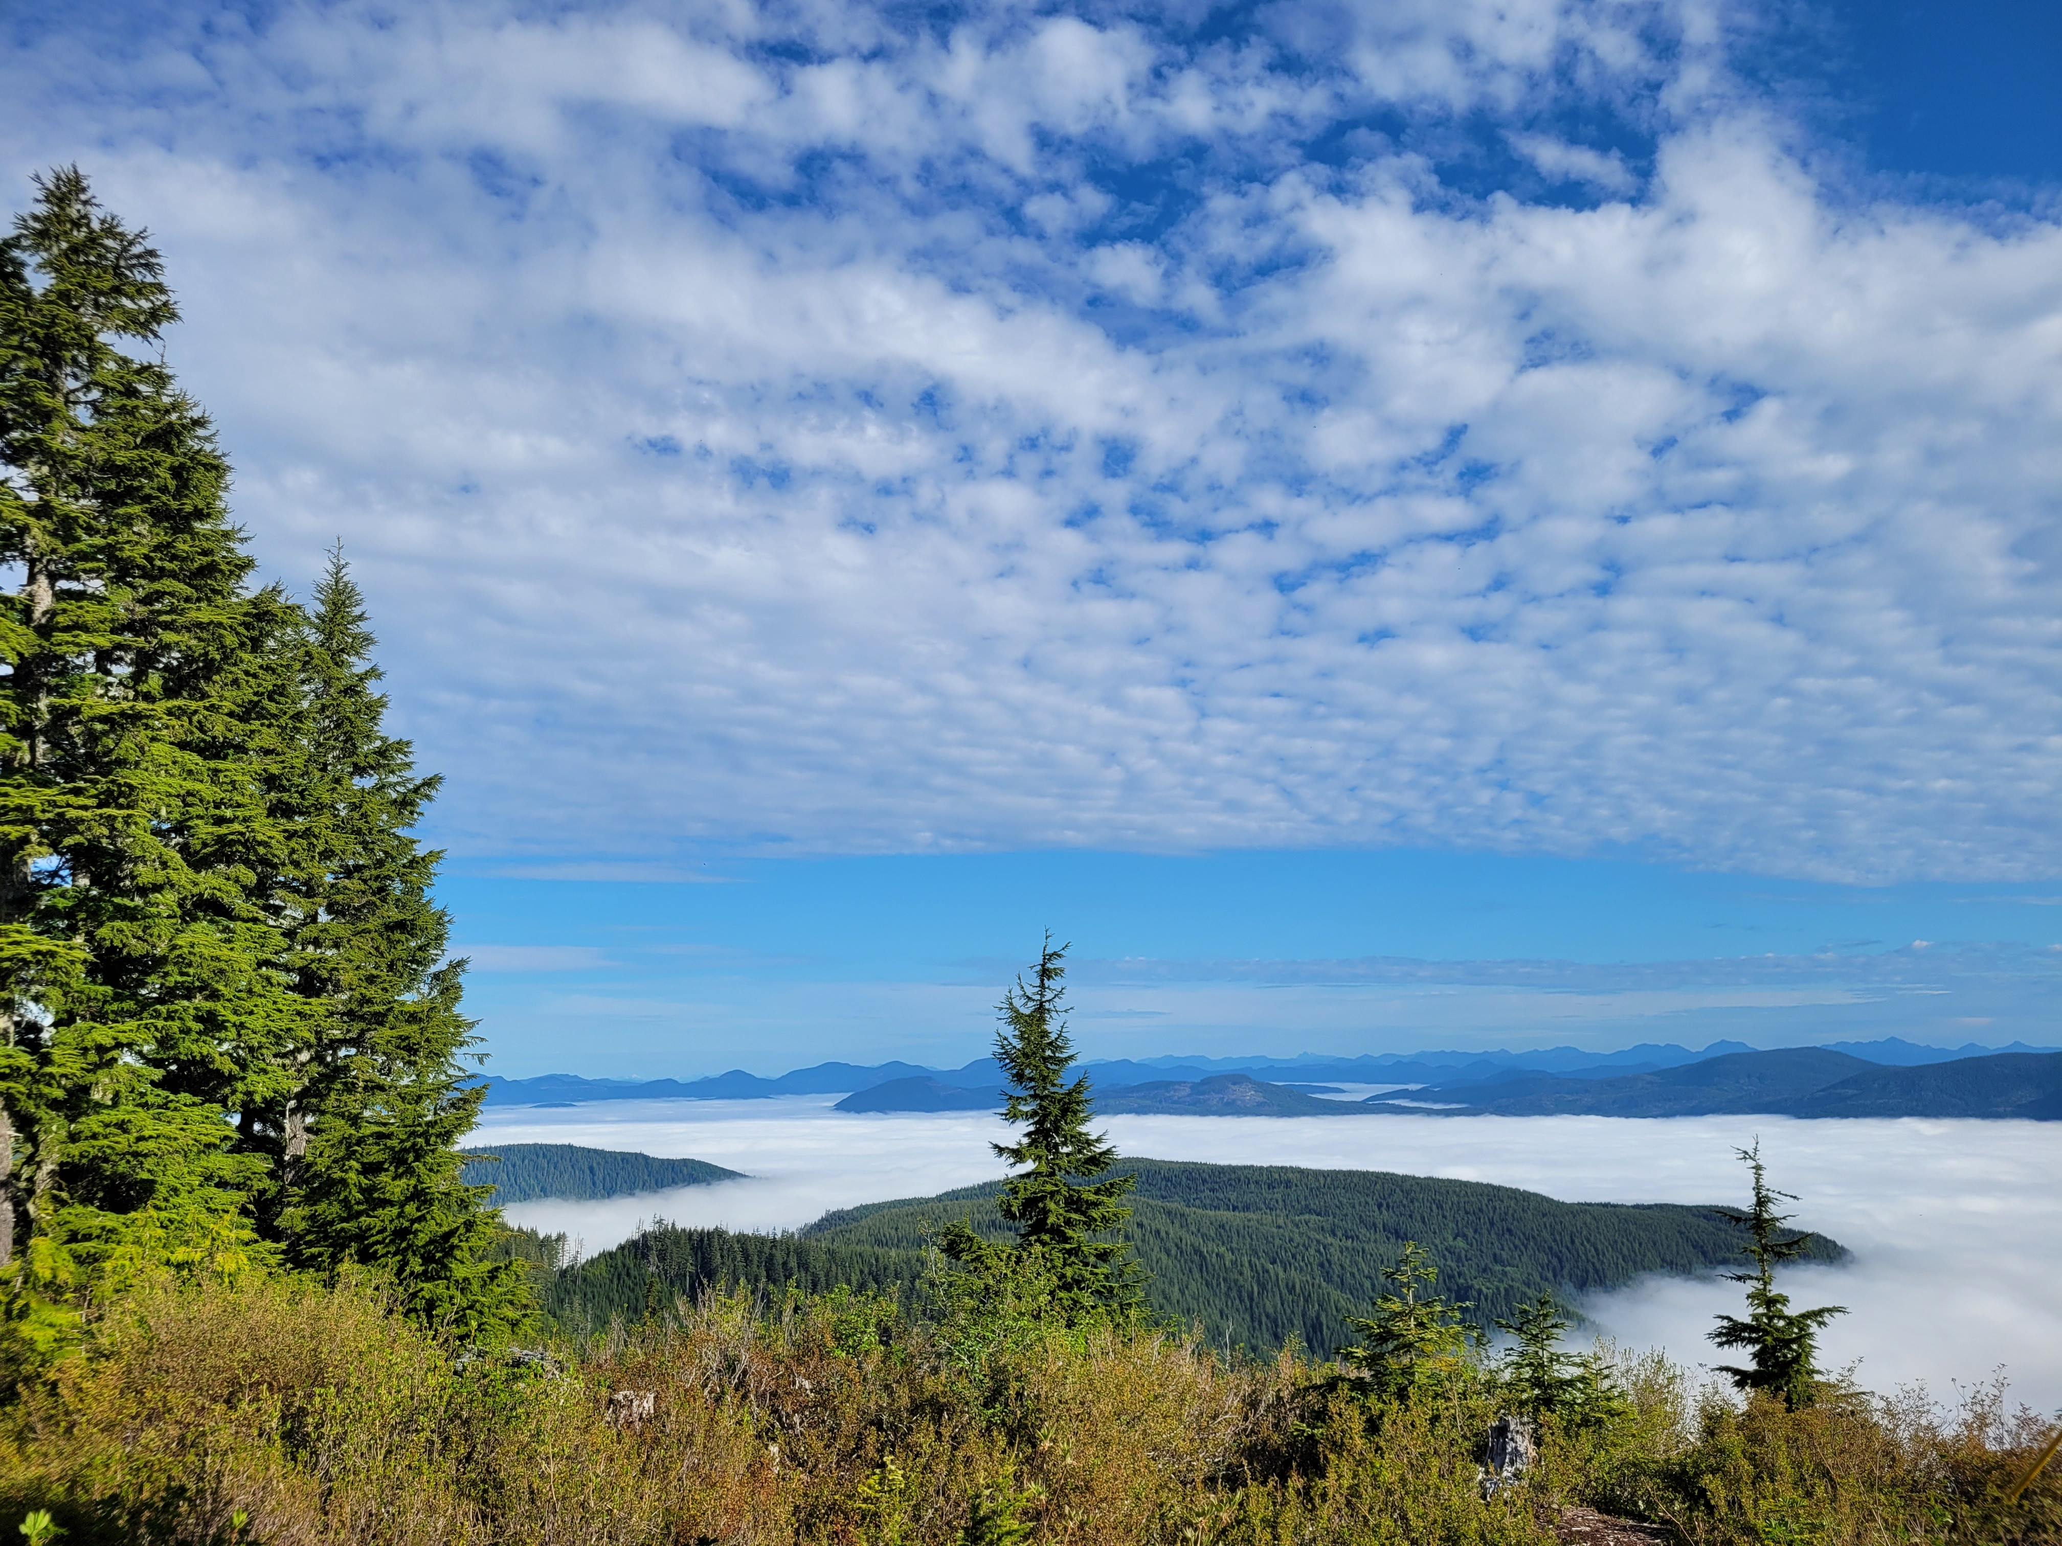

Tella Osler
Cameron Gillingham
Aaron Huinink

Slide 2
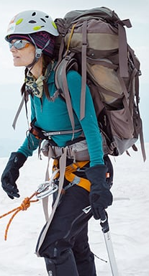
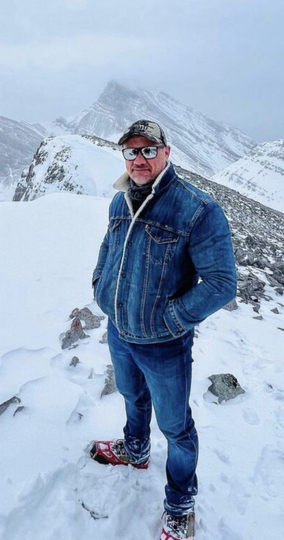
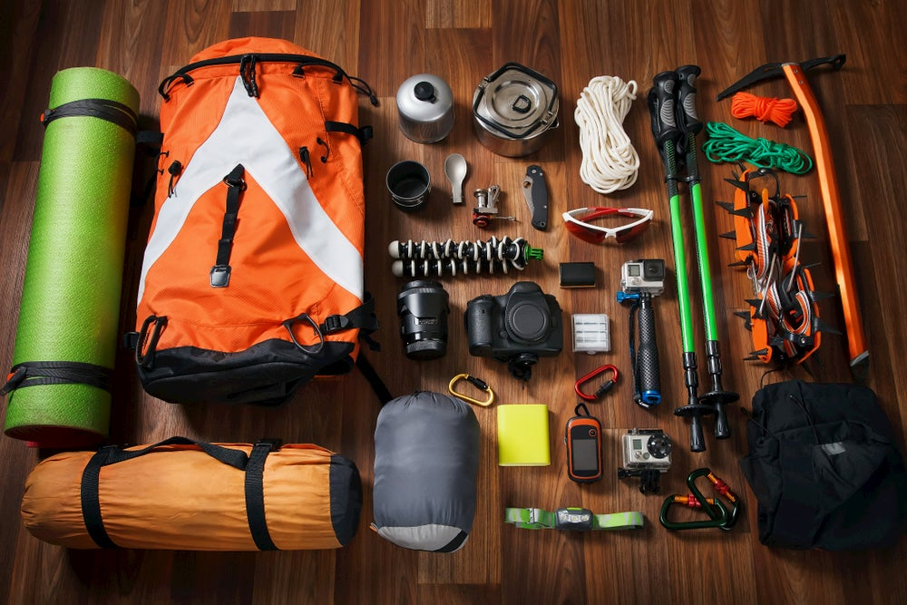

What do these hikers have in common?
Notes:
Is It OK To Hike In Jeans? (>800 Hikers Weigh In!) - Chasing Summits

Slide 3

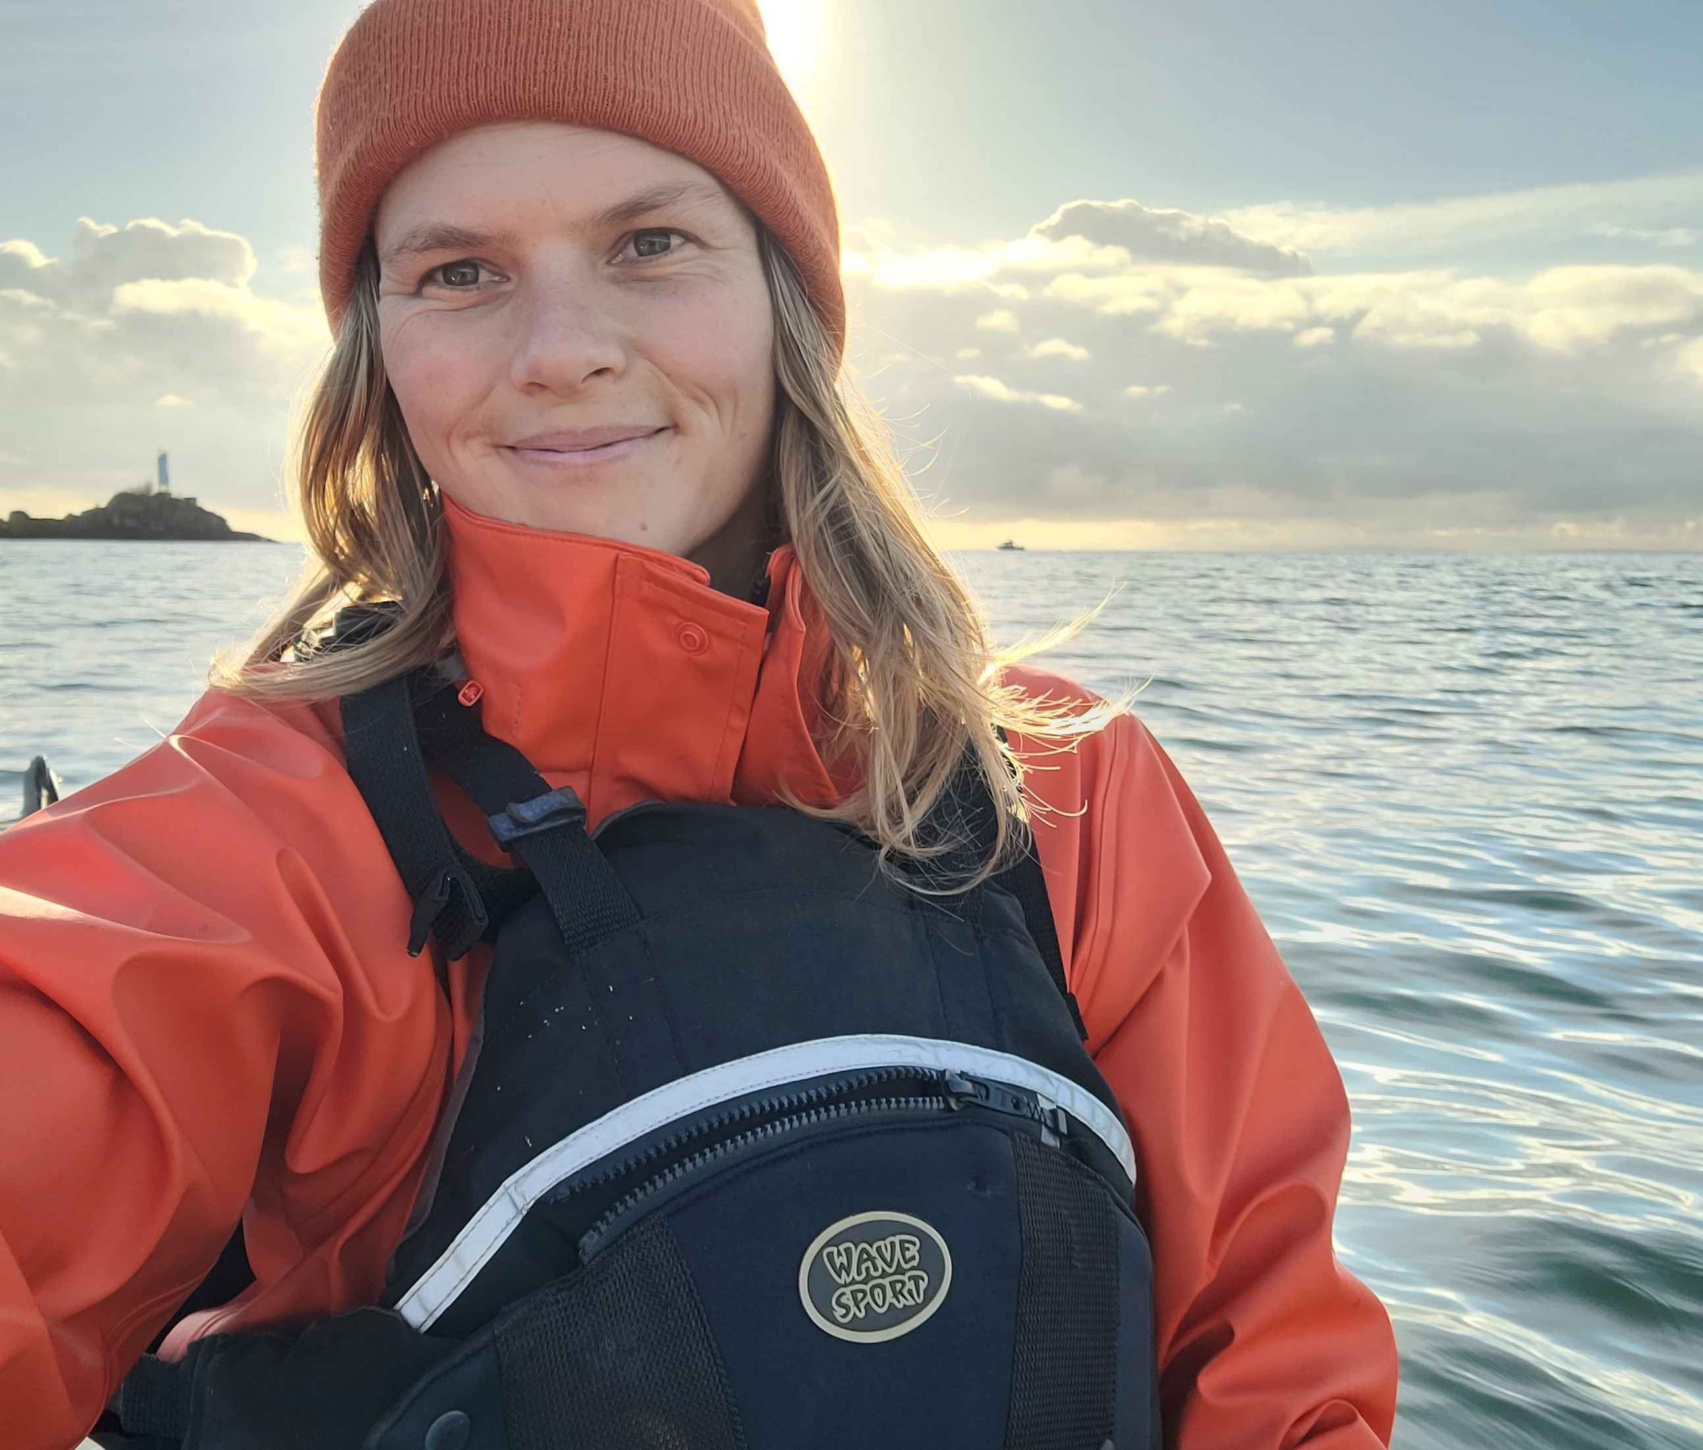
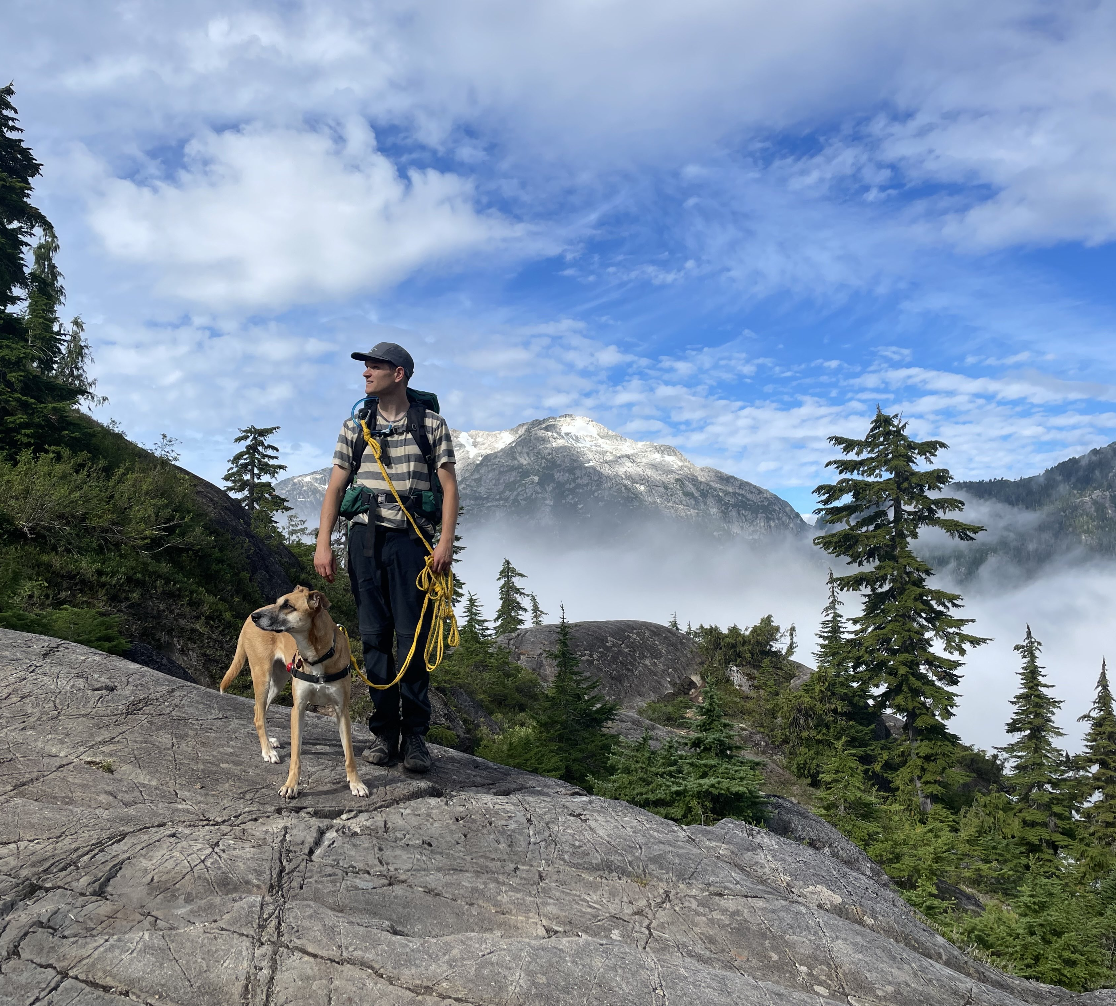
Our Team
Aaron Huinink
Tella Osler
Cameron Gillingham
Notes:
Our Team

Slide 4
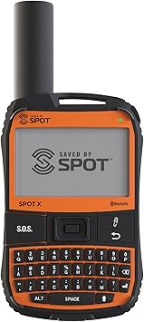
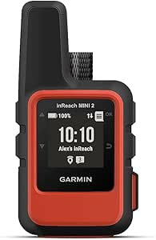
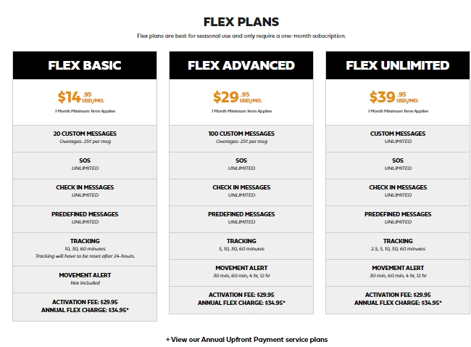

Plug & Play Solutions
GARMIN INREACH
$ 519 CAD
(amazon.ca)
SPOT X
$ 349 CAD
(amazon.ca)

Slide 5
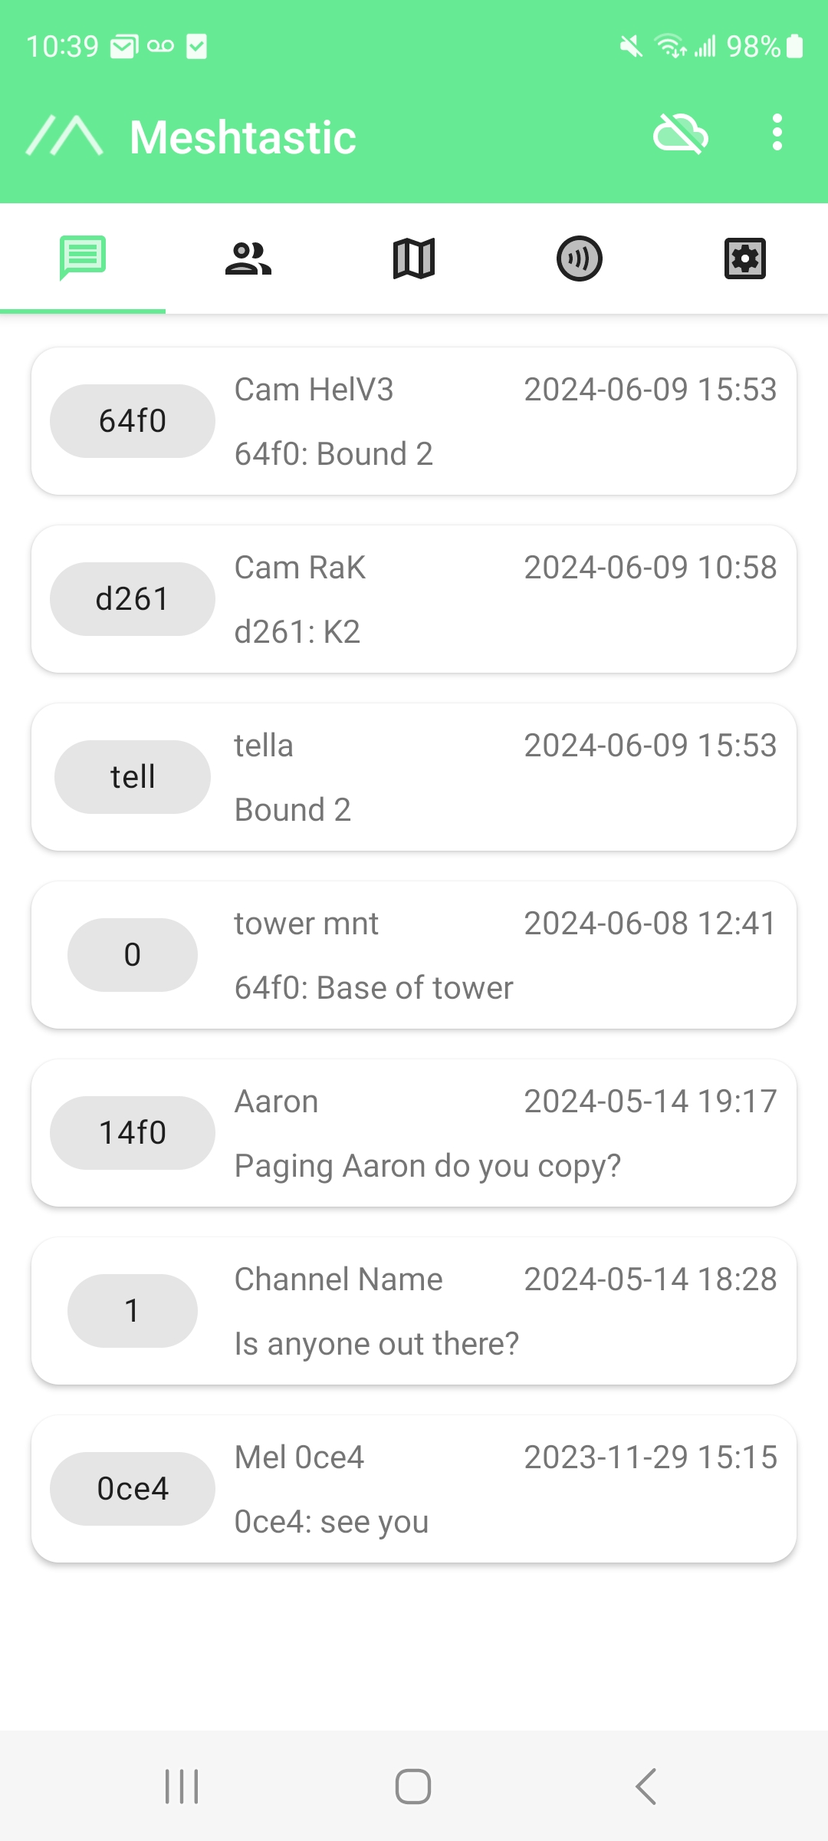
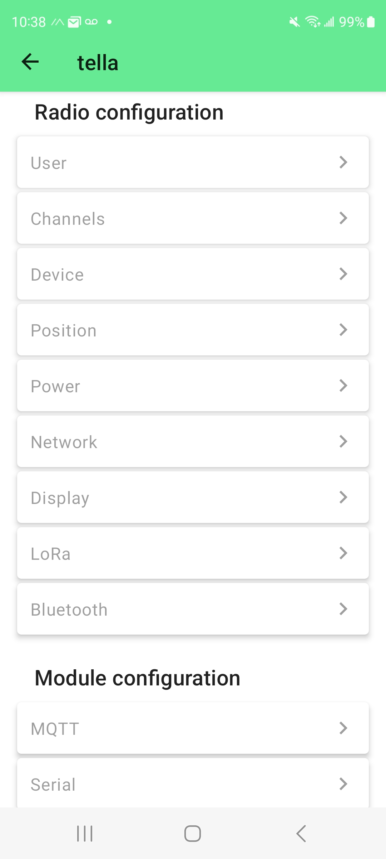
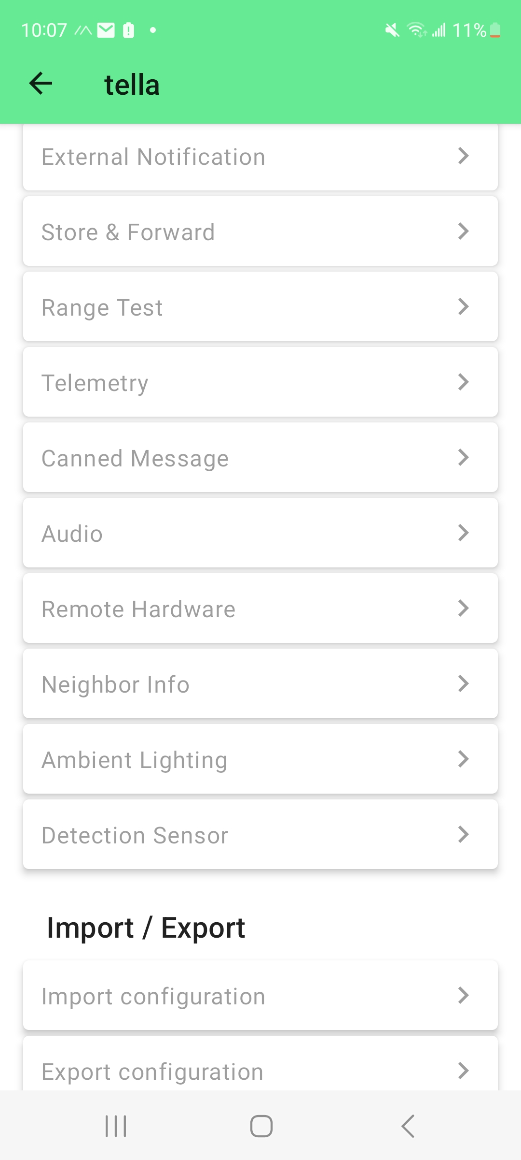
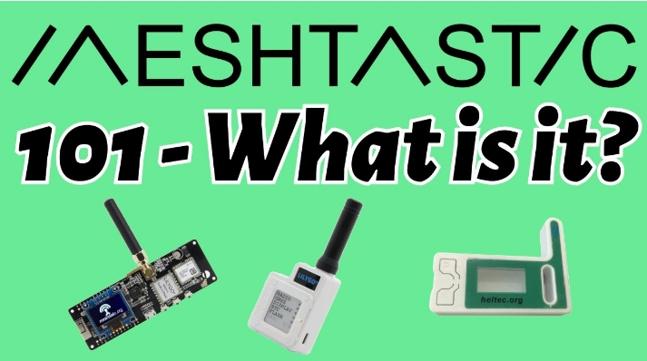
Tech-Savvy?

Slide 6
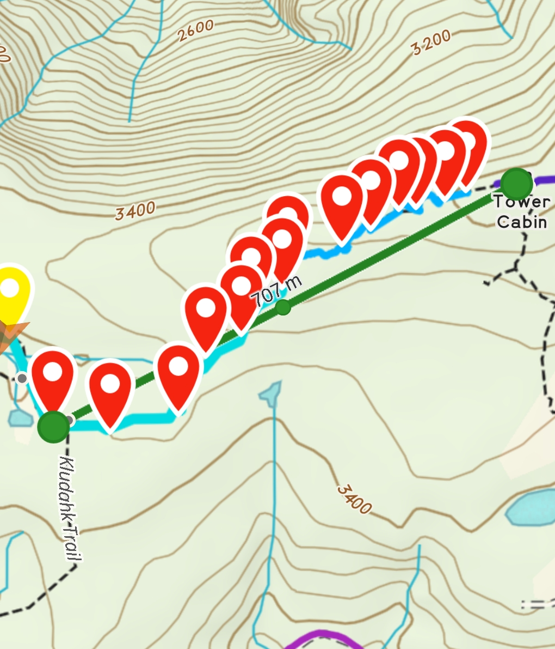
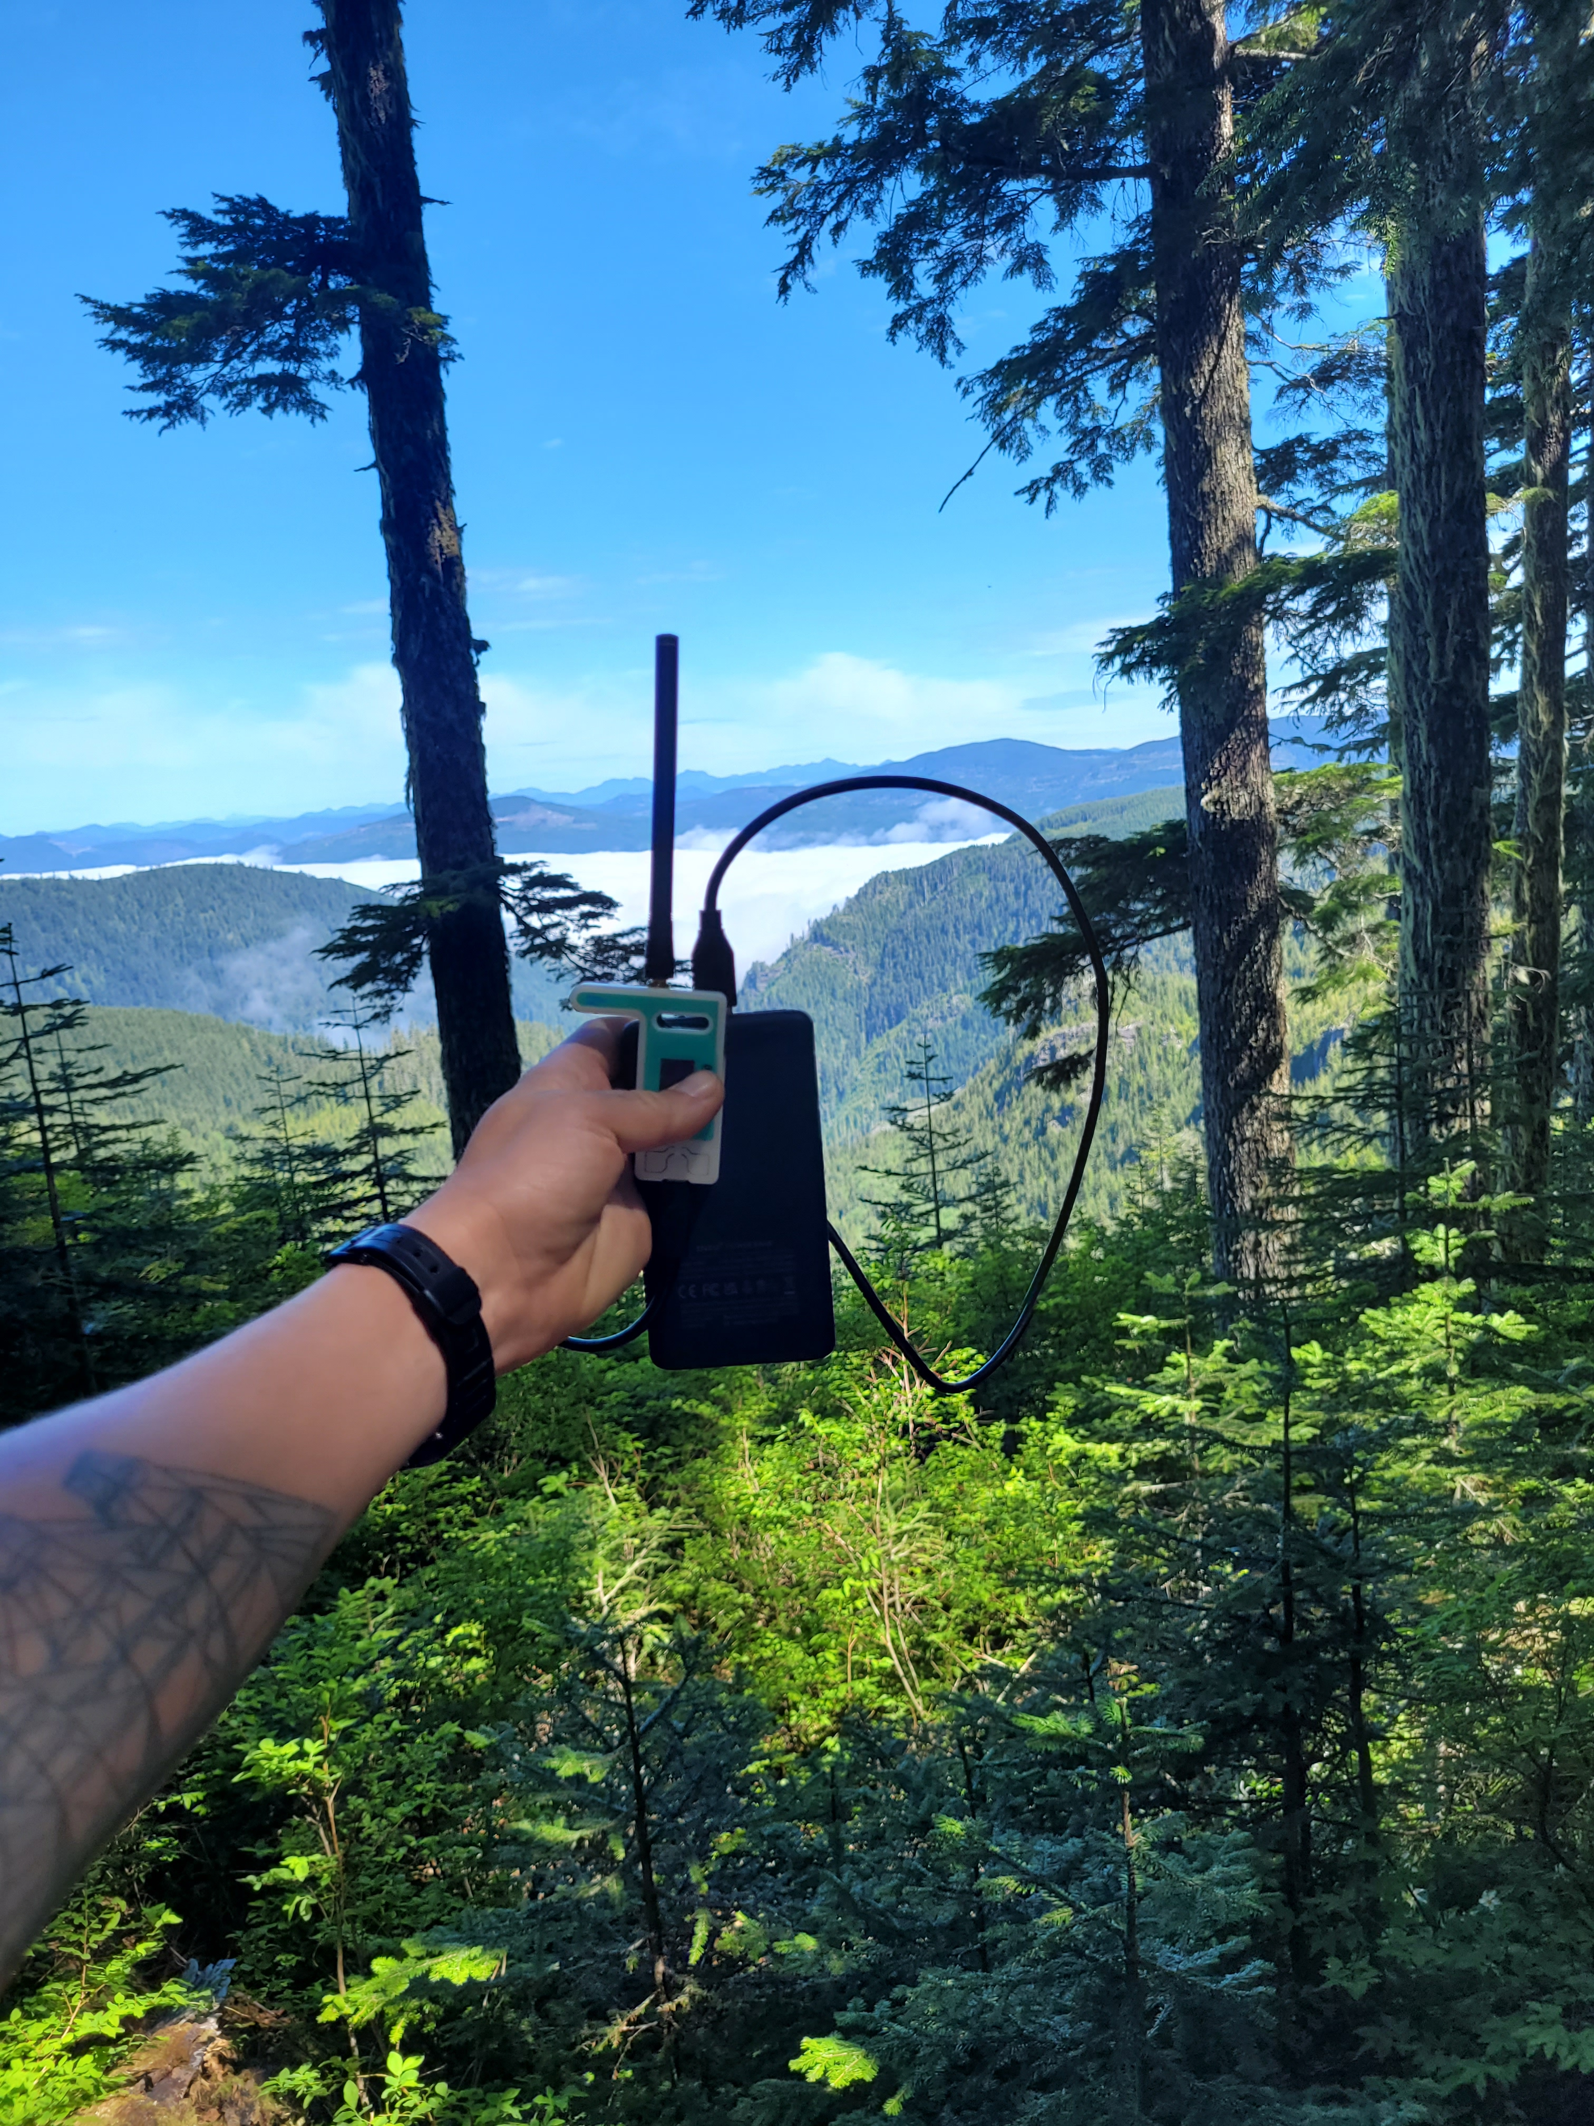
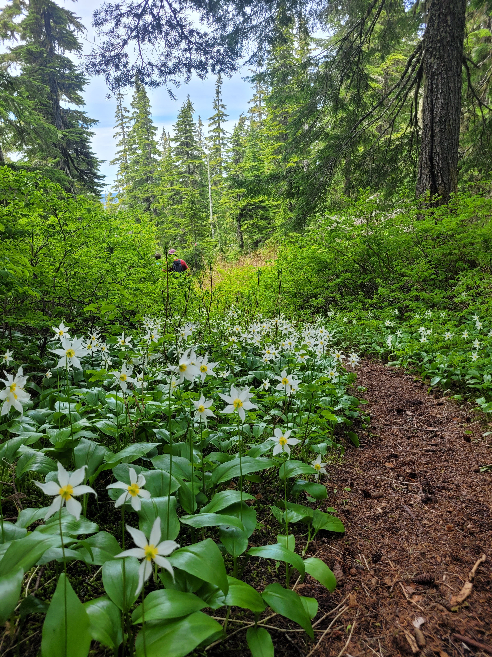
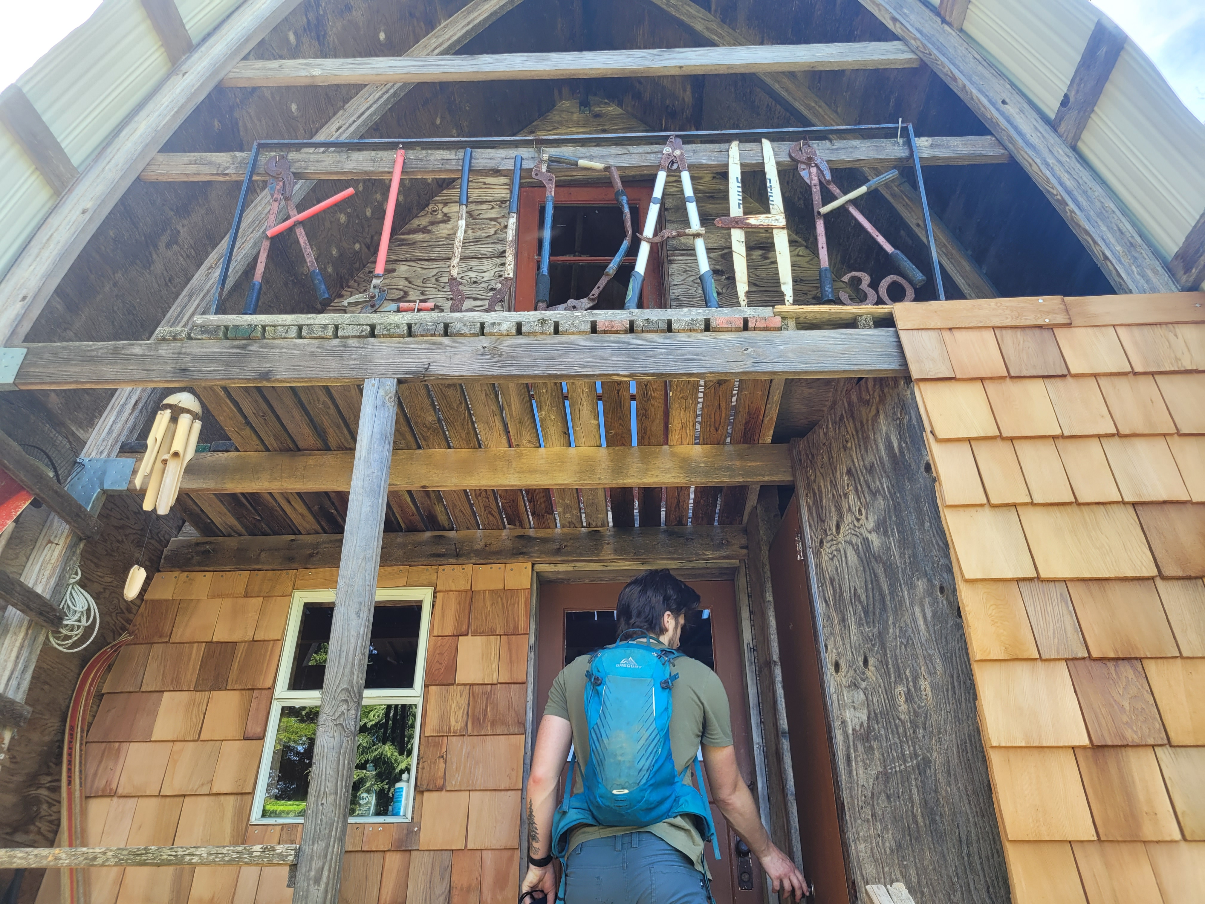
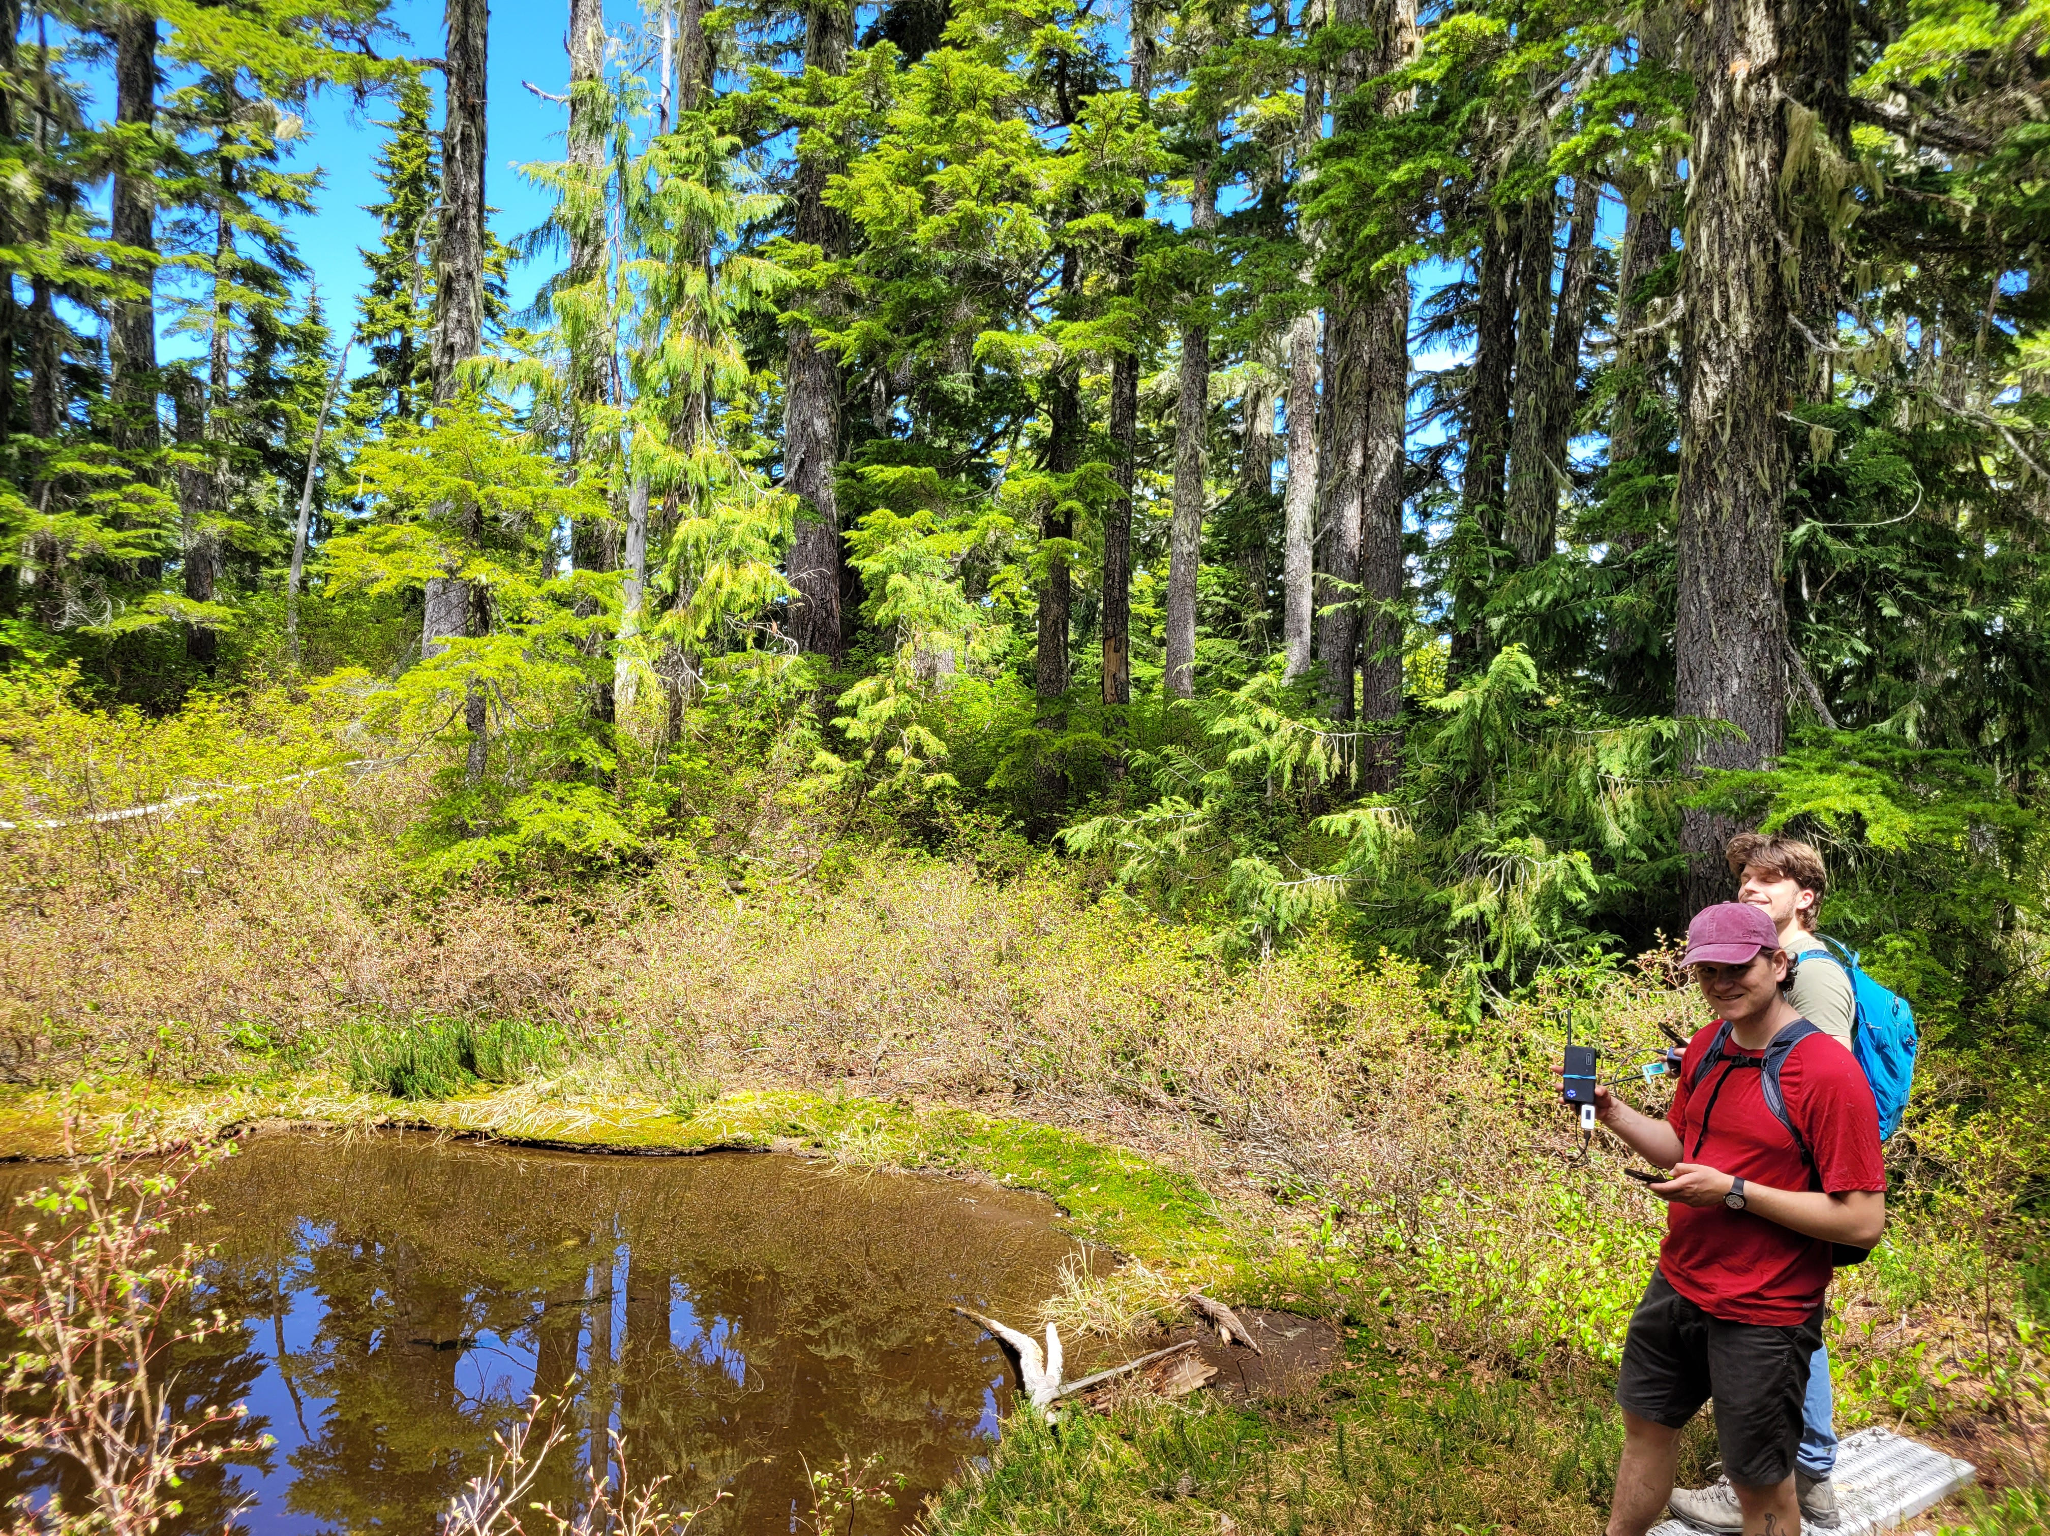
Proving Feasibility

Slide 7



Our Solution
Petal
Digital Radio
Petal
Digital Radio
Petal
Digital Radio
LoRa
LoRa
Wi-Fi
Wi-Fi
Wi-Fi
Notes:
We are designing a LoRa-capable digital radio (Petal) and a full-stack repeater network solution called AVAlink. Instead of requiring users to have an expensive satellite device, our repeaters will host a browser-based web application so that anyone with a smartphone can access the network. Users will send messages via the Avalink web application which will be transmitted along the mesh network and accessible by other users. In the future, we hope to integrate our network with existing emergency services, like search and rescue and 911.

Slide 8
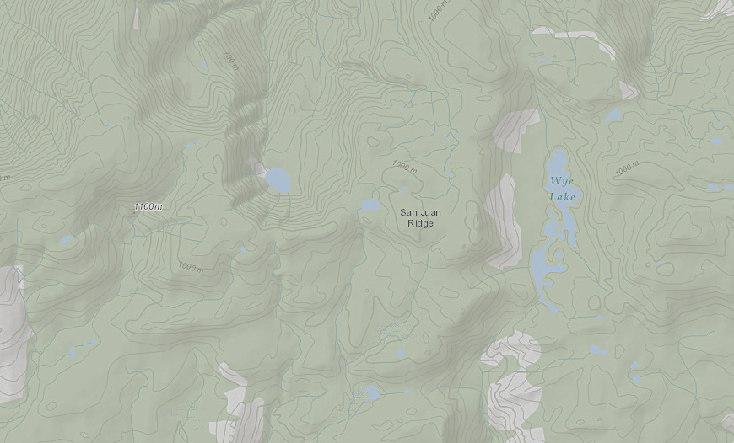
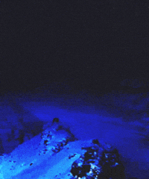
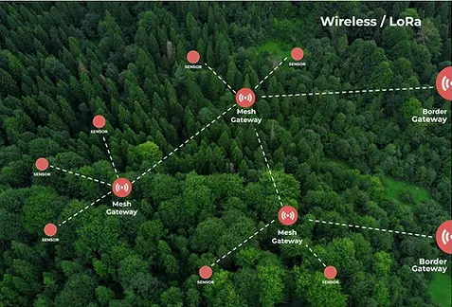
Mesh Network
Notes:
LoRa Mesh Network
So what is a mesh network?

Slide 9
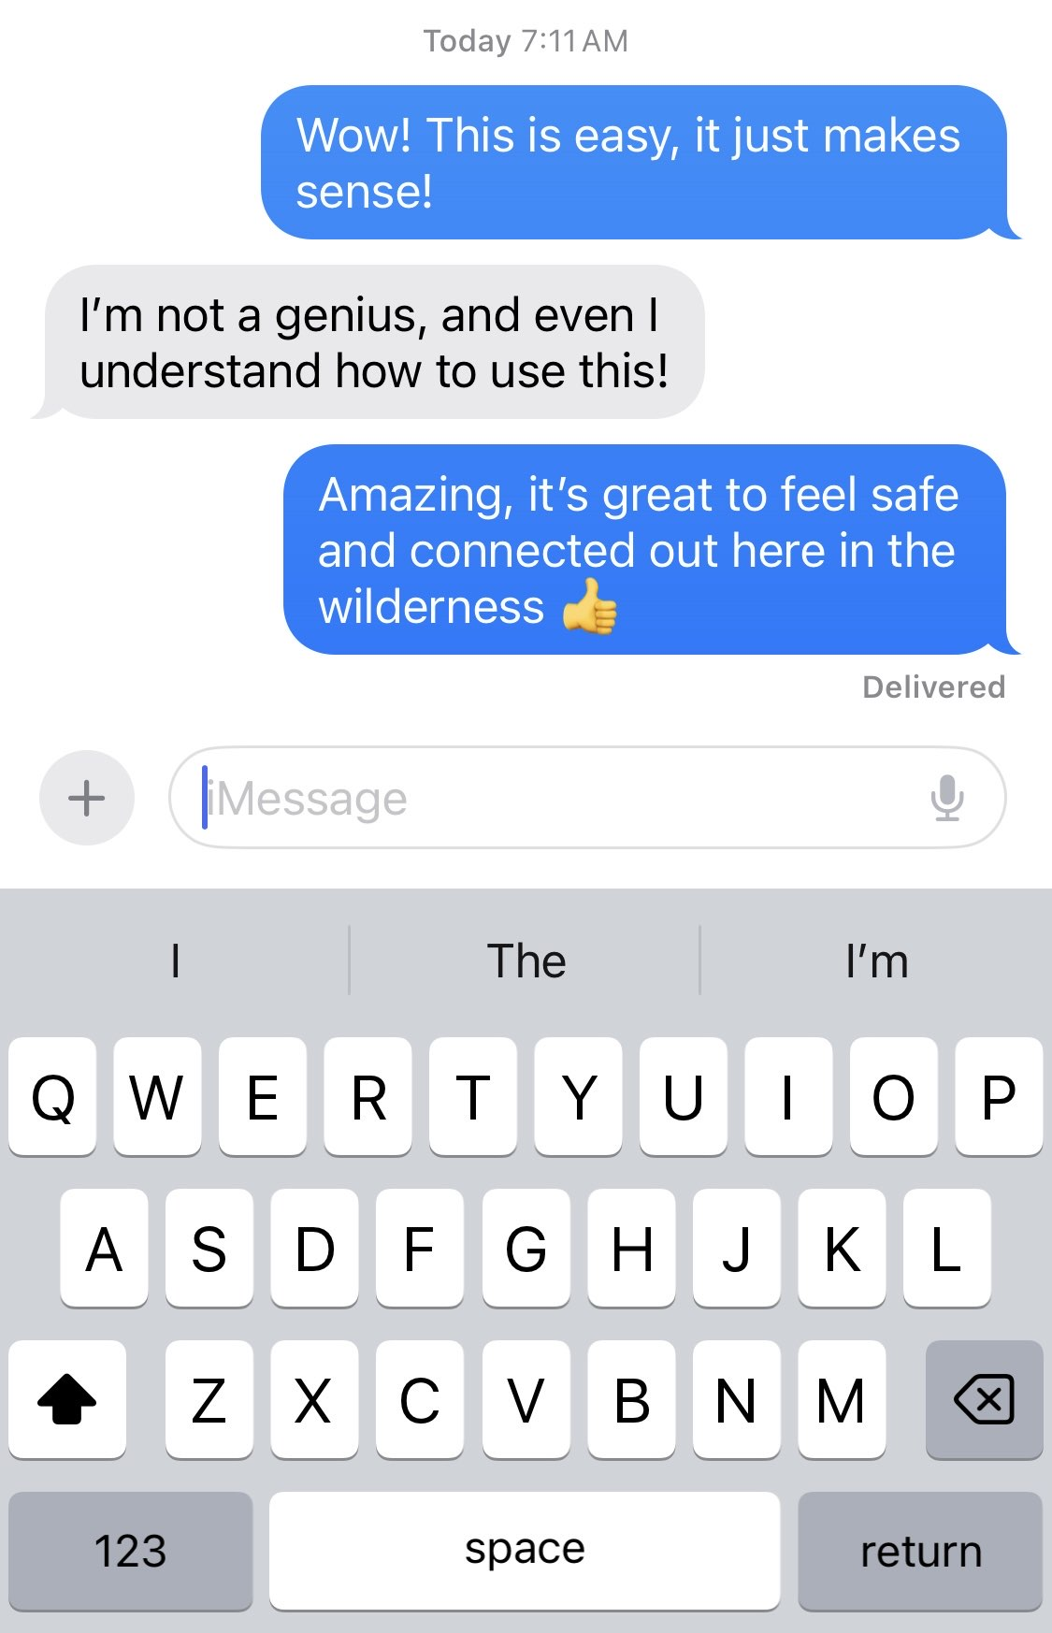

How will it work?
Notes:
How will it work: The user will connect to our wifi network hosted by a node. They will scan a QR code, launching the AVAlink webapp. No configuration, no need to make an account, just a simple messenger allowing users to communicate with other nodes or send an SOS alert in the event of an emergency. This design achieves our goal for everyone to intuitively understand how to use our platform without it having unnecessary feature bloat.

Slide 10


Robust Hardware
ESP32-S3
SX1262 LoRa Transceiver
SD
AVAlink web app
Petal Radio node
Notes:
Hardware
The petal nodes will be built using robust and efficient hardware. The local wifinetwork will be hosted by an esp32 s3 module which doubles as our microprocessor. WE chose this because it is wifi capable, has plenty of gpios, and its dual core architecture gives us plenty of processing capability for a low financial and power pricetag. An SD card will hold the web application files and chat logs, while The digital radio side will be handled by a Semtech LoRa transceiver which is the standard of choice for LoRa and IoT devices. We’ve also designed a low cost, high efficiency power supply that accommodates a wide range of battery and solar configurations.

Slide 11


User-friendly Software
Users Smart Phone
Local Server
ESP32
LoRa Transceiver
Wifi
HTTP Requests
SPI Bus
Notes:
Software/Firmware
This is a high level diagram of the Software and Firmware architecture we will be using. We are going to use the Blazor platform to develop a Web application because it can be served by the microprocessor as a web assembly file. This will offload the computing power to the user’s smartphone instead of the microprocessor. We have chosen to use the RUST programming language for our embedded development because of its memory safety, easy to use tooling and high performance.
Rust logo - https://rustacean.net

Slide 12
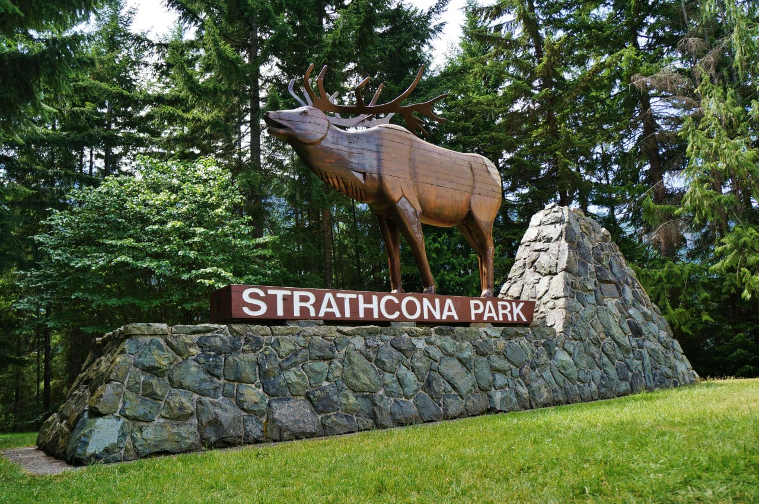
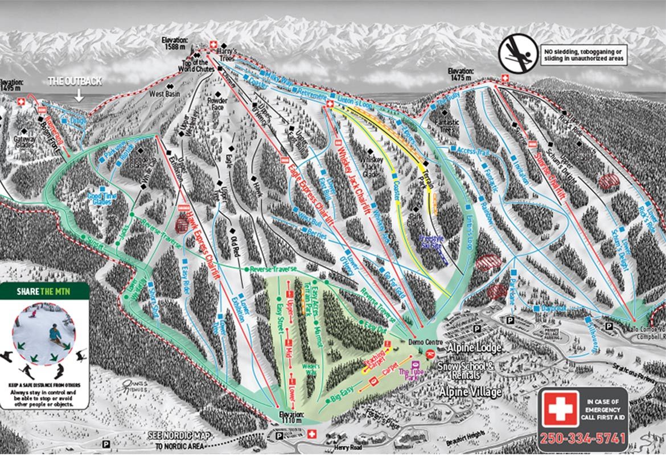
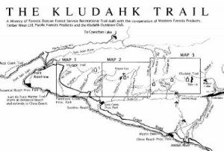
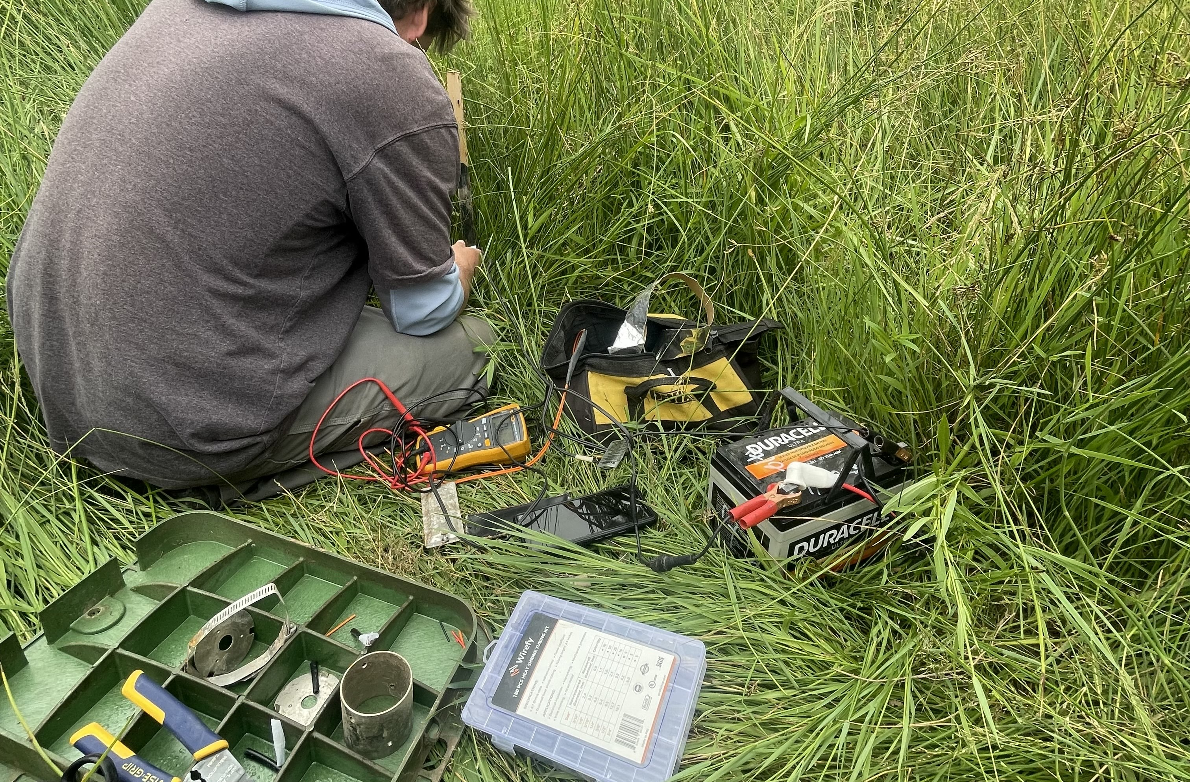
Provincial And National Parks
Ski Resorts
High Traffic Trails
Field Work
Notes:
Target Market
We aim to target established organizations that oversee remote areas and see a large volume of casual visitors. Our design can be implemented in Provincial or National Parks, high traffic hiking trails, field work operations, or recreation areas outside cellular service.

Slide 13
How would you spend your money?
$700
$700
Notes:
FINANCIALS
Now imagine for a moment that you run a nature tourism outfit.
- safe, accessible without compromising the experience
- cell phones are a no go
For $700 you could purchase a single in reach with 5 months of service
- Covers only a single person
Or, based on our budget
You could produce 9 nodes
Anyone can use it
Large coverage area.
Lower operating costs
Lower latency
We expect prototype to cost around $50/unit, but we hope to shave that down to around $30 once in production
- no more specialty modules
Depending on solar and battery requirements,

Slide 14

Leveling the playing field
Notes:
Is It OK To Hike In Jeans? (>800 Hikers Weigh In!) - Chasing Summits

